Slide 1
W4153 – Cloud Computing Lecture 12: Sample Project, EDA/MDP, API-GW, Advanced Composition, GraphQL, Kubernetes
© Donald F. Ferguson, 2024

Slide 2

Contents
2 | W4153-F24-12-Sample-Project-EDA/MDP-AdvancedCompotion-APIGW-GraphQL-Kubernetes © Donald F. Ferguson, 2024

Slide 3
Contents
Semester roadmap and completion
Project presentation and demo schedule and format.
Next few lectures.
Sample, illustrative project
Architecture “big picture.”
API gateway.
Tokens and context headers the simple version.
Some “internet stuff:” domains, DNS, certificates, … …
Advanced composition
Project discussion:
Power Rangers, Application: Cloud Casino
CC Team, Project Idea: Food Rating App

Slide 4
Semester Roadmap and Completion
4 | W4153-F24-12-Sample-Project-EDA/MDP-AdvancedCompotion-APIGW-GraphQL-Kubernetes © Donald F. Ferguson, 2024

Slide 5
Completion and Roadmap
Lectures remaining:
Today introduces material
22-NOV will introduce some additional concepts that you will include in your final project.
29-NOV is a holiday.
06-DEC will cover some additional, interesting topics and may introduce one or two very simple additional requirements.
Final project:

Slide 6
Overall Architecture
6 | W4153-F24-12-Sample-Project-EDA/MDP-AdvancedCompotion-APIGW-GraphQL-Kubernetes © Donald F. Ferguson, 2024

Slide 7
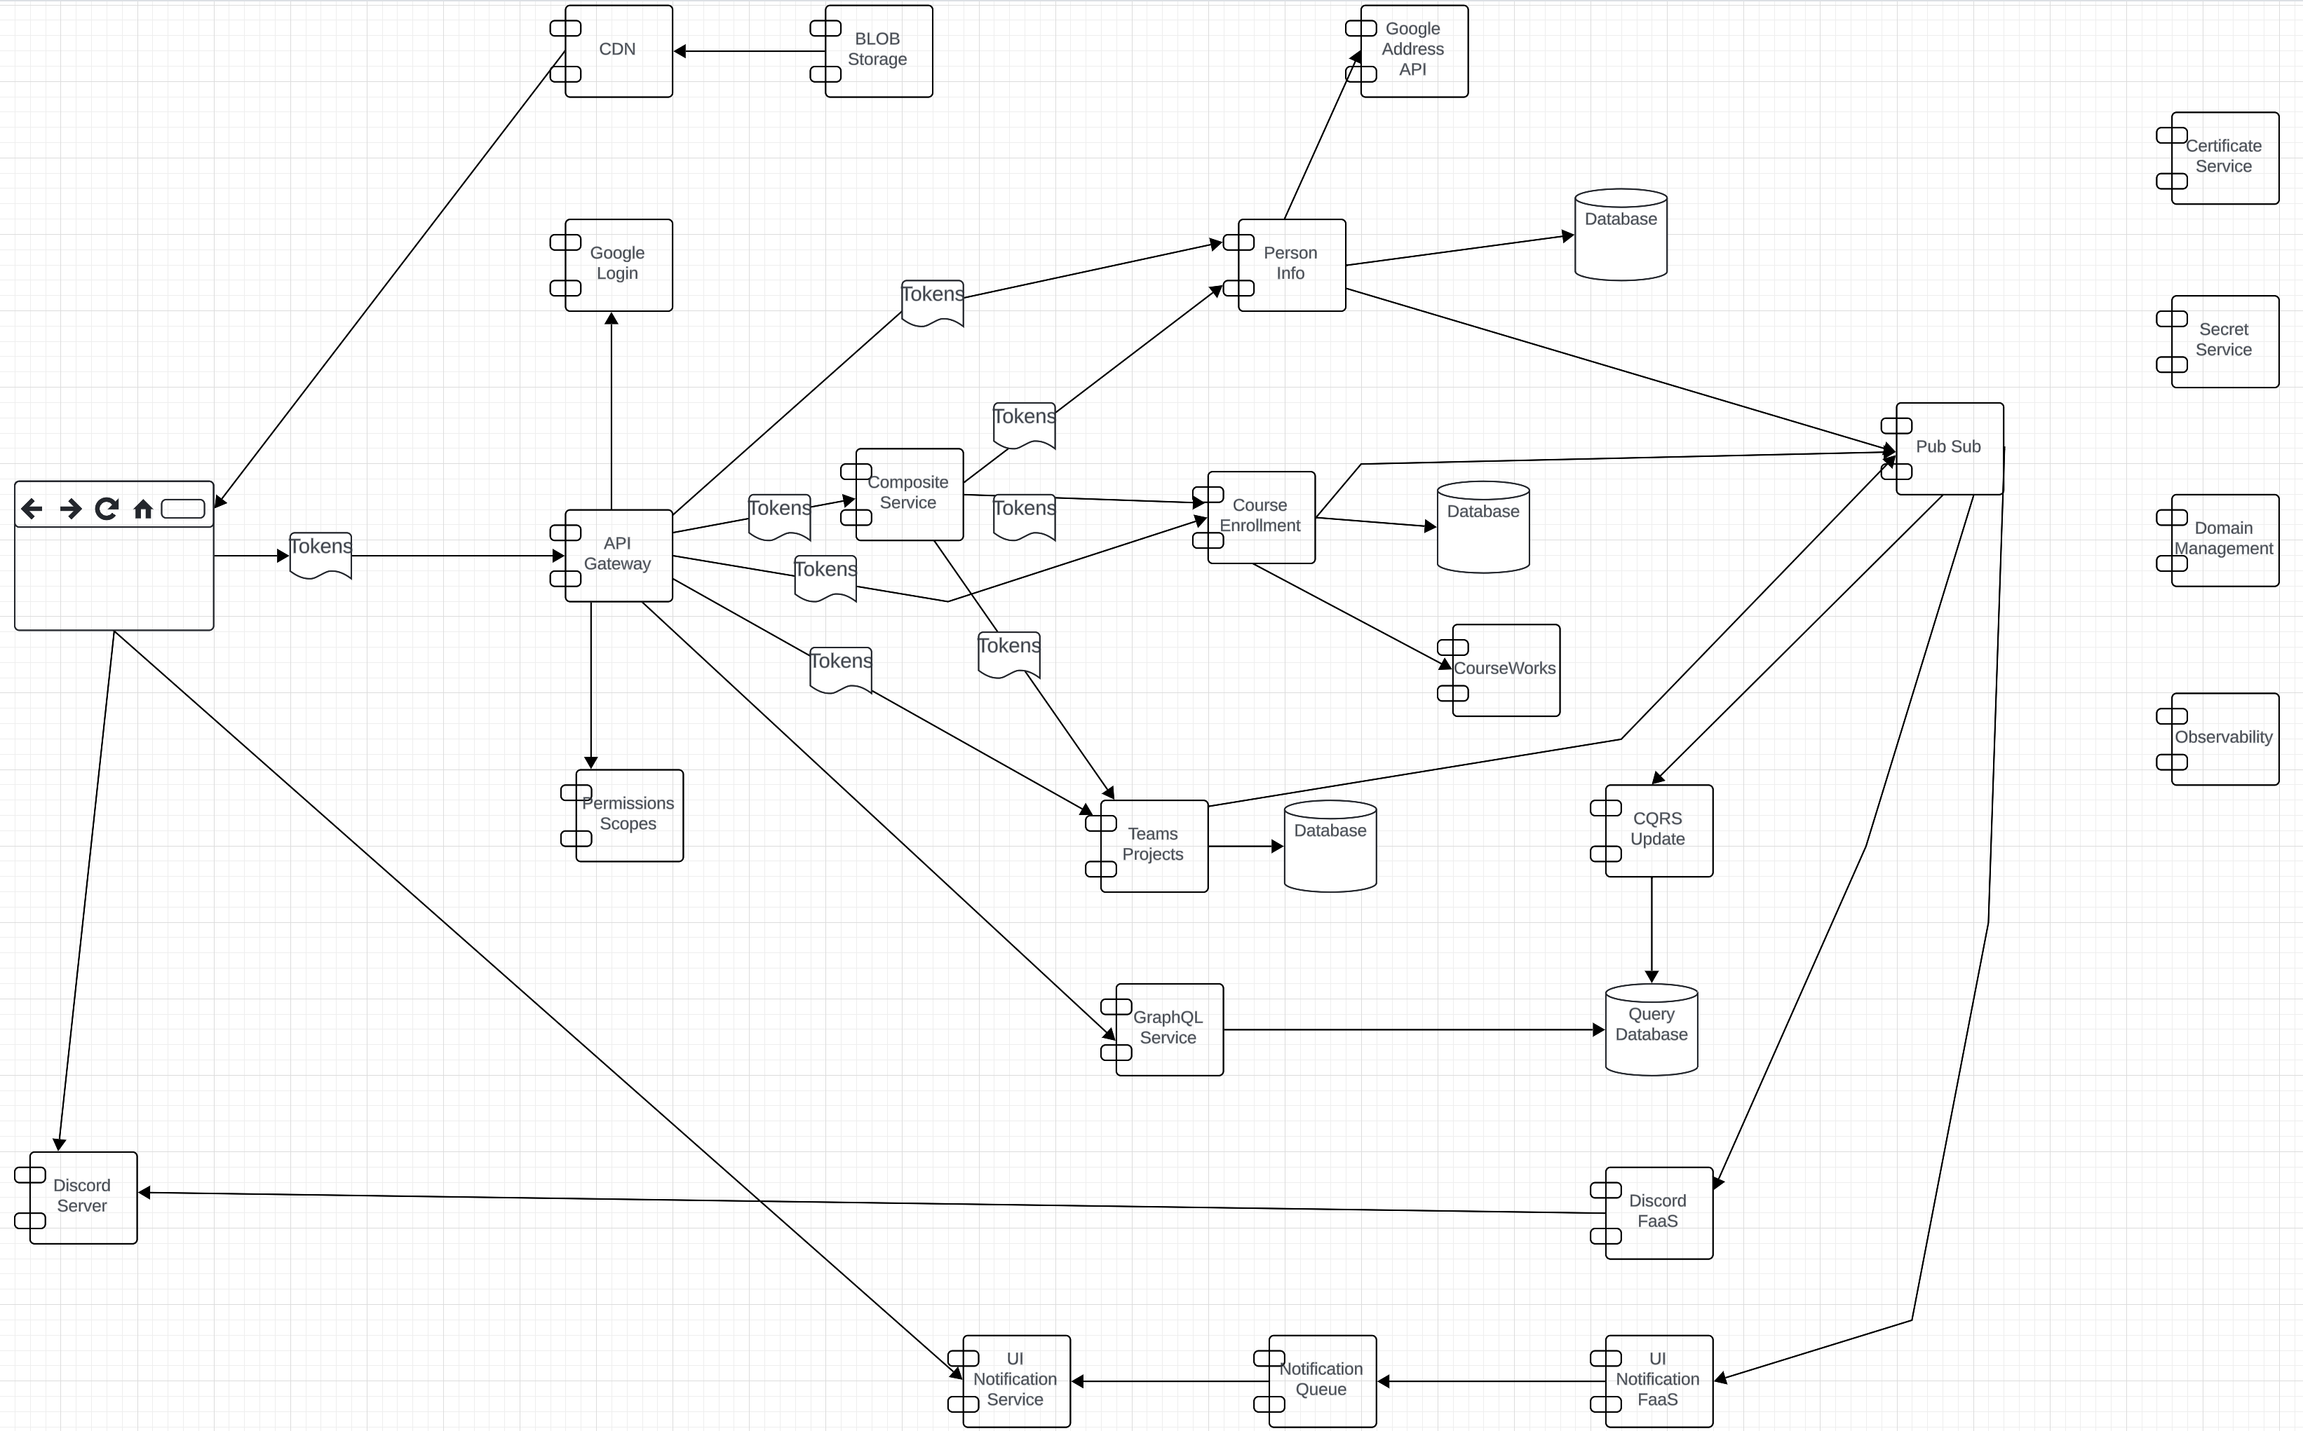
Overall Architecture

Slide 8
API Gateway
8 | W4153-F24-12-Sample-Project-EDA/MDP-AdvancedCompotion-APIGW-GraphQL-Kubernetes © Donald F. Ferguson, 2024

Slide 9
Overview and Concepts
API Gateway
9 | W4153-F24-12-Sample-Project-EDA/MDP-AdvancedCompotion-APIGW-GraphQL-Kubernetes © Donald F. Ferguson, 2024

Slide 10
API Gateway

Slide 11
Terms
From Wikipedia
“API management is the process of creating and publishing web application programming interfaces (APIs), enforcing their usage policies, controlling access, nurturing the subscriber community, collecting and analyzing usage statistics, and reporting on performance. API Management components provide mechanisms and tools to support developer and subscriber communities.”
Gateway: A server that acts as an API front-end, receives API requests, enforces throttling and security policies, passes requests to the back-end service and then passes the response back to the requester. A gateway often includes a transformation engine to orchestrate and modify the requests and responses on the fly. A gateway can also provide functions such as collecting analytics data and providing caching. The gateway can provide the functionality to support authentication, authorization, security, audit and regulatory compliance. Gateways can be implemented using technologies like Nginx or HAProxy.

Slide 12
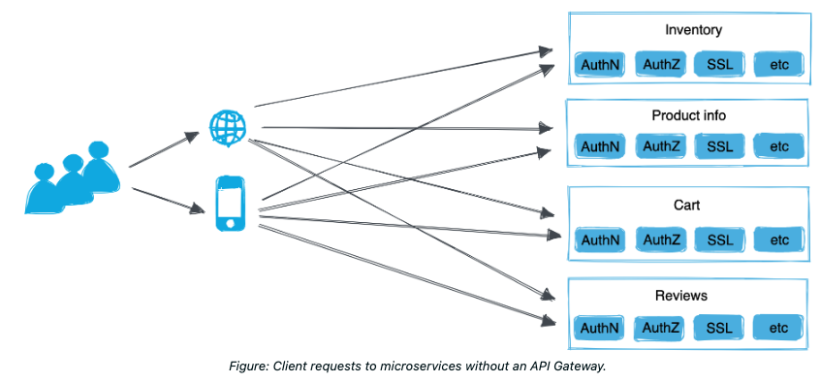
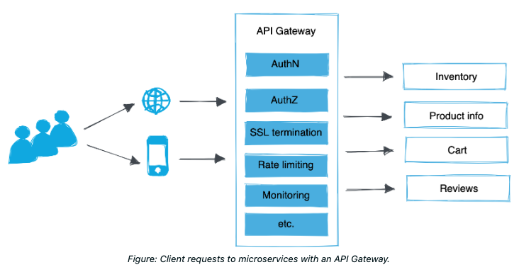
API Gateway
https://docs.solo.io/gloo-mesh-gateway/main/concepts/about/api-gateway/
Solo.io is an example (this is not a recommendation): https://docs.solo.io/gloo-mesh-gateway/main/concepts/about/api-gateway/
There are many, many API GWs
All major cloud service providers have one or more API gateways.
There are several open-source API GWs.
There are several commercial products.

Slide 13
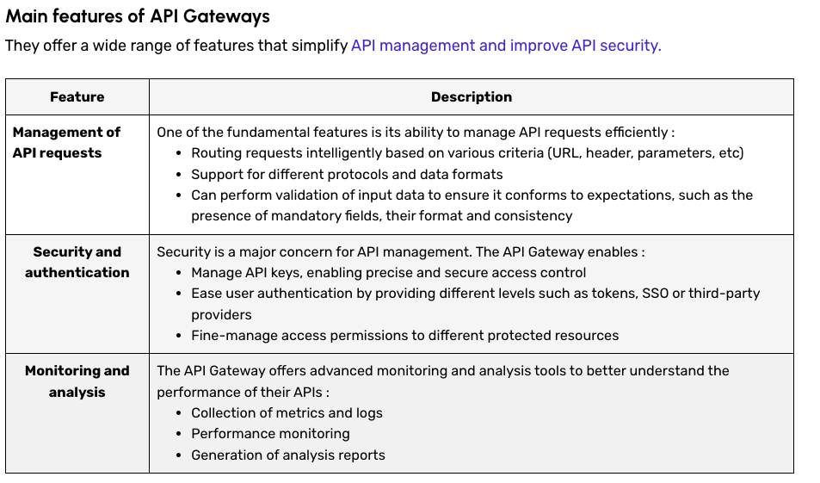
API Gateway
https://datascientest.com/en/api-gateway-how-it-works-and-its-advantages

Slide 14
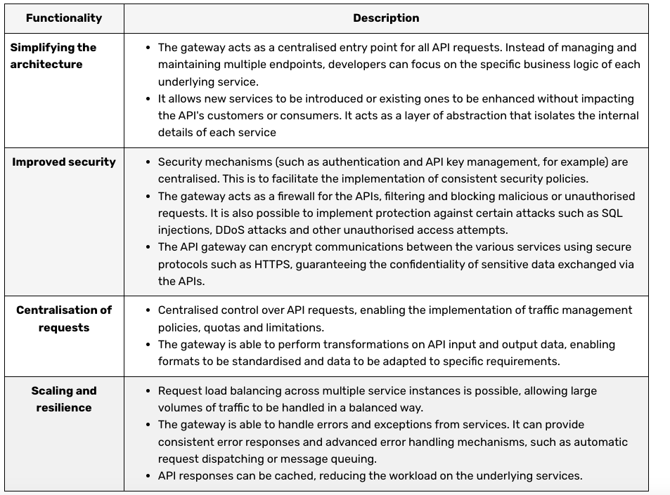
API Gateway Benefits

Slide 15
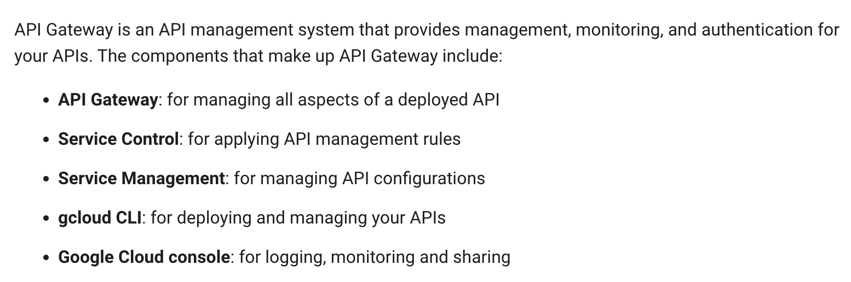
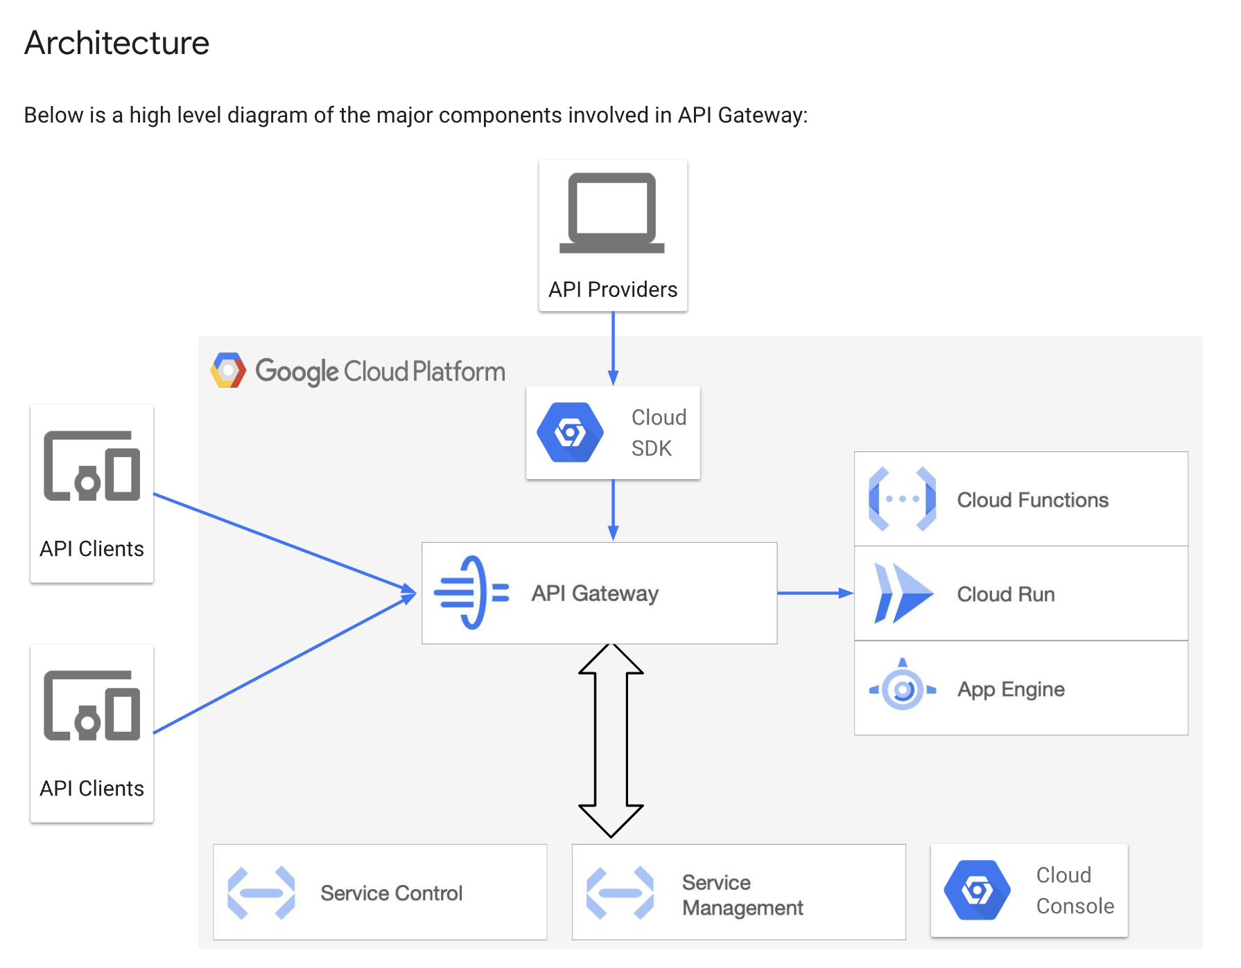
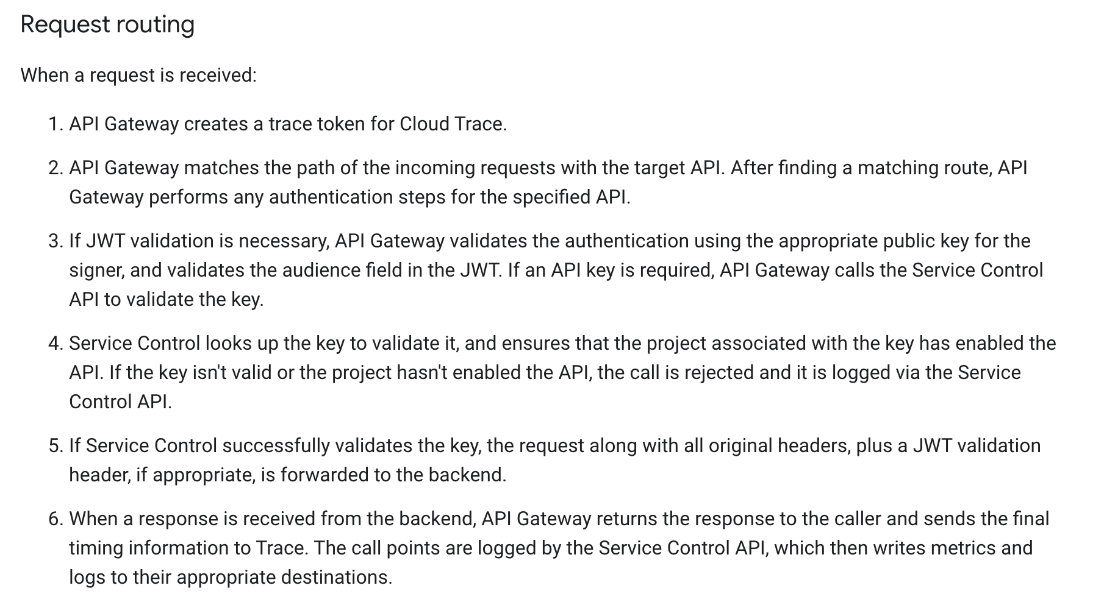
Google API Gateway

Slide 16
API Gateway Summary
You will have to set up an API gateway for two or three of your microservices.
You can use either AWS or GCP.
The minimal functionality expected is:
A single, logical URL space with routing.
Some form of authentication/authorization checking (but can be very simple).
Basic logging and trace.
You do not need to deeply or completely integrate with end-to-end trace, observability, single sign on/login, etc.

Slide 17
Tokens
Scope Propagation
Observability
API Gateway
17 | W4153-F24-12-Sample-Project-EDA/MDP-AdvancedCompotion-APIGW-GraphQL-Kubernetes © Donald F. Ferguson, 2024

Slide 18
API Gateway

Slide 19
API Gateway
What the heck is that stuff?

Slide 20
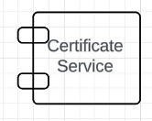
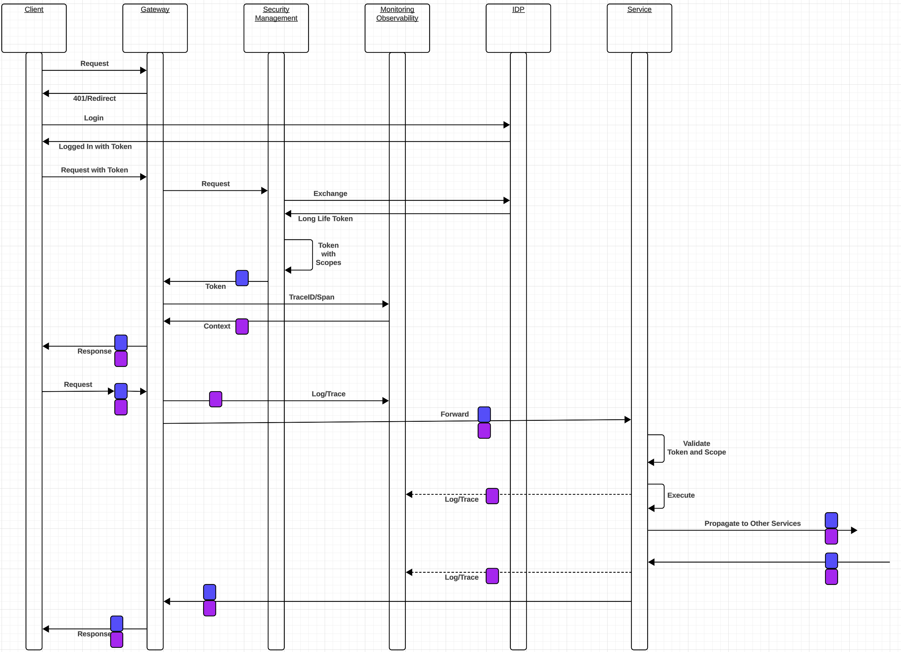
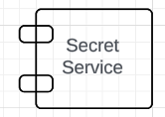
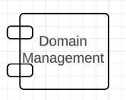
Conceptual Model
Service:
Validates token using signature and shared secret.
Usually in middleware.
Makes authorization decision based on claims, scopes, etc.
Browser relies on certificate for trusting the site/gateway.
Configure the certificate in the gateway, etc.
Browser maintains JWT tokens in session or local storage.

Slide 21
Some Network Stuff
21 | W4153-F24-12-Sample-Project-EDA/MDP-AdvancedCompotion-APIGW-GraphQL-Kubernetes © Donald F. Ferguson, 2024

Slide 22
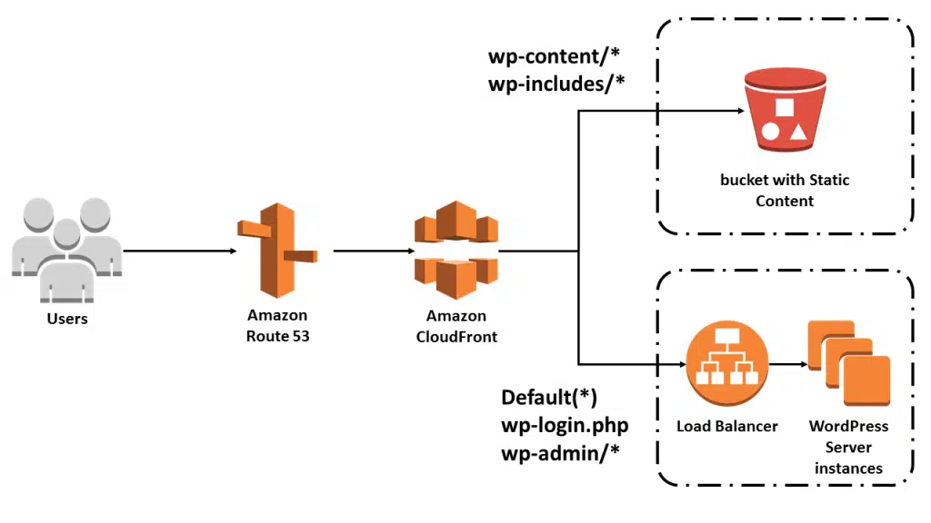
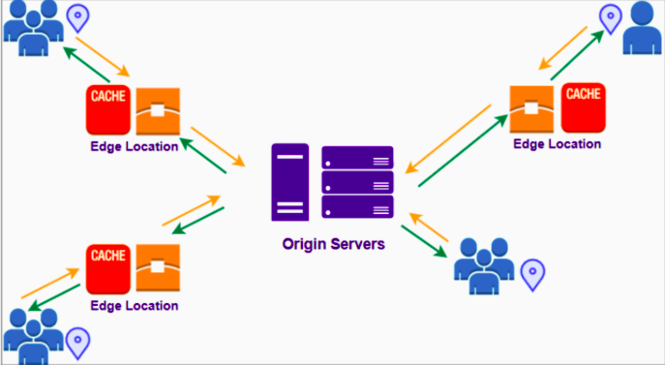
CloudFront Example
Show the following on AWS:
CloudFront
Route 53
AWS Certificate
S3 Buckets
What do you have to do?
Do not worry about DNS, certificates, etc. You can usually use an icky one that comes with the CSP.
You should serve content from blob storage.

Slide 23
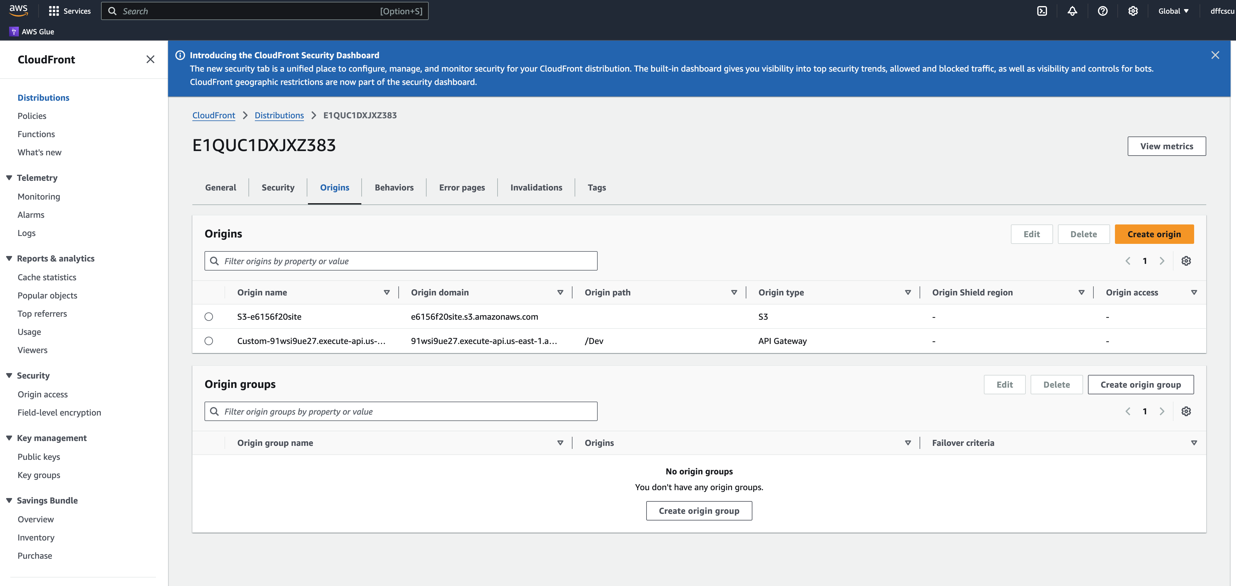
CloudFront
Show Certificate

Slide 24
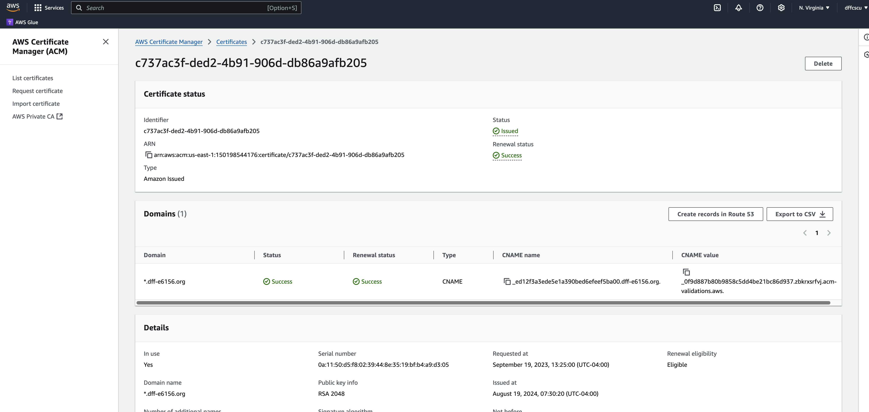
Certificate

Slide 25
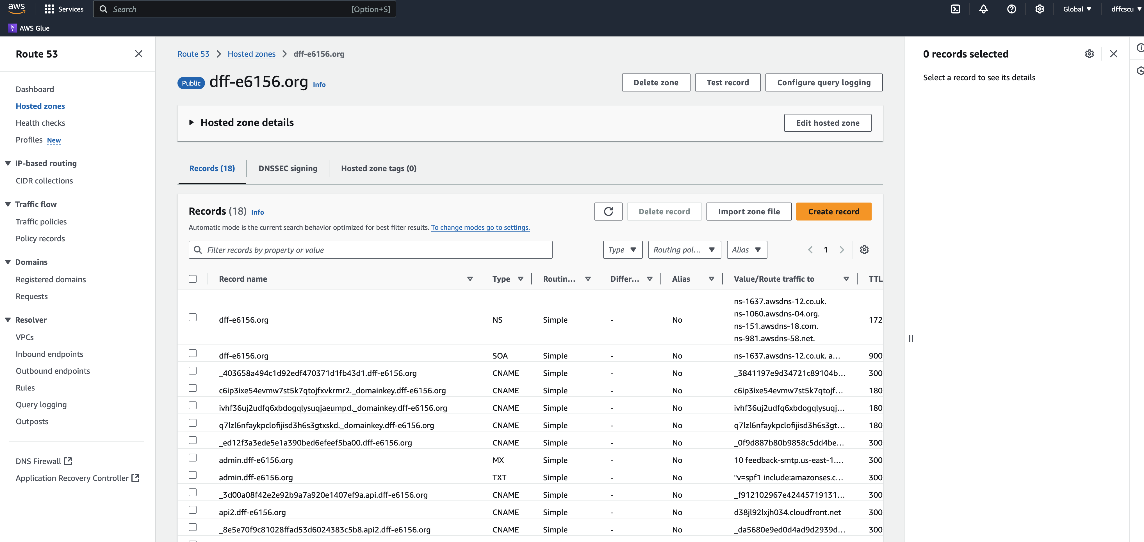
Domain

Slide 26
Some URLs
Some URLs
https://e6156f20site.s3.us-east-2.amazonaws.com/index.html
https://d1kc4b5azlamci.cloudfront.net/index.html
https://www.dff-e6156.org/index.html
Implications for your project:
You should use a “BLOB storage service” for your ”web frontend content.” There are countless articles about the pros and cons of various approaches, e.g. https://medium.com/dowebthings/improve-your-page-speed-by-hosting-your-static-website-with-aws-s3-and-cloudfront-d0e881812092
Getting and managing a domain, DNS entries, etc. is a pain in the neck.
Figuring out how to integrate with custom certificates adds lower back pain.
Do not worry about domains and certificates. Most CSPs will generate ugly, icky certificates and domain names for BLOB stores, microservice endpoints, … …

Slide 27
Advanced Service Composition
27 | W4153-F24-6-REST(4)-OAuth2-Middleware-Composition © Donald F. Ferguson, 2024

Slide 28
Concepts Reminder and Overview
API Gateway
28 | W4153-F24-12-Sample-Project-EDA/MDP-AdvancedCompotion-APIGW-GraphQL-Kubernetes © Donald F. Ferguson, 2024

Slide 29
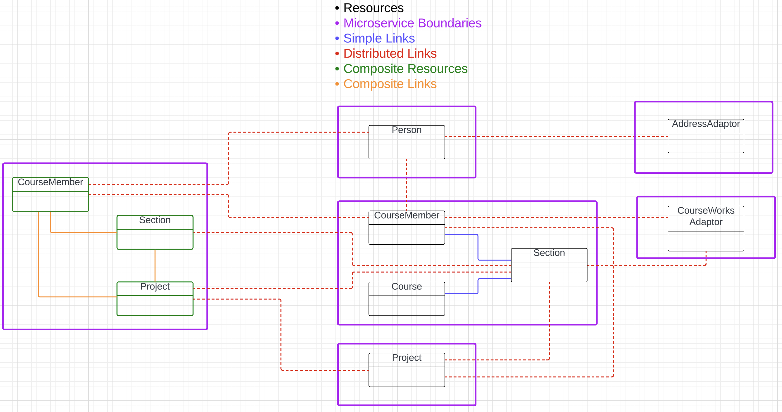
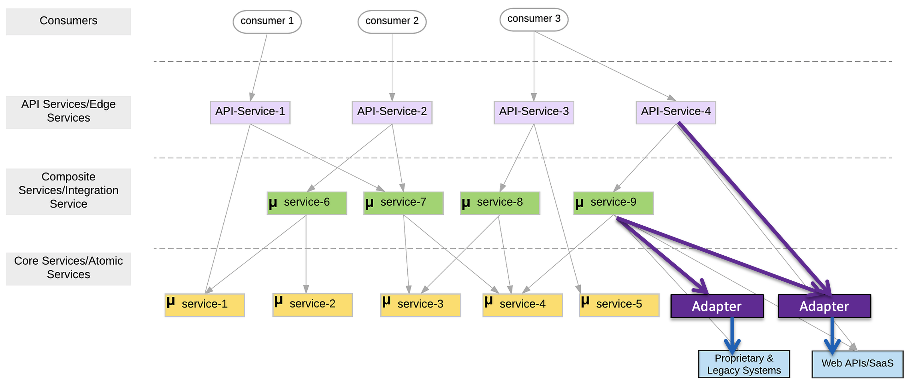
Composition Concepts and Reminder
There are two aspects to “composition:”
Structure: How do I “link things together” to “find services” that a microservice needs?
Behavior: How do I implement the application of logic of the composite?
Two models: Orchestration and Choreography.
Several approaches to implementing the service methods: synchronous code, asynchronous code, event driven architecture, message driven architecture, state machines/workflows, … …
Use pattern like CQRS to “optimize” queries?

Slide 30
CQRS
and GraphQL
API Gateway
30 | W4153-F24-12-Sample-Project-EDA/MDP-AdvancedCompotion-APIGW-GraphQL-Kubernetes © Donald F. Ferguson, 2024

Slide 31
CQRS and GraphQL
What the heck is that stuff?

Slide 32
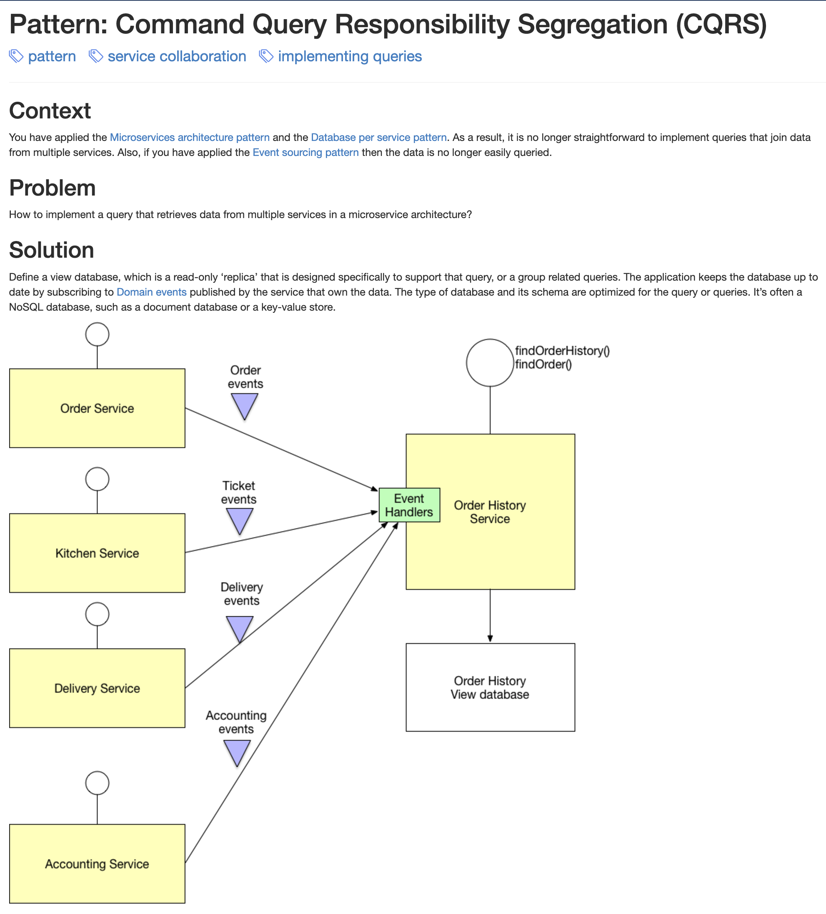
CQRS
We have seen that microservices leads to little bits of “data” all over the place.
Something that a user thinks of as a “thing” is scattered all over the place.
We have seen how to handle this issue using various patterns for composition.
But,
Most of the time things are not changing.
The vast majority of requests are reads.
I would like something more view like and with better query support than just query string in URLs.

Slide 33
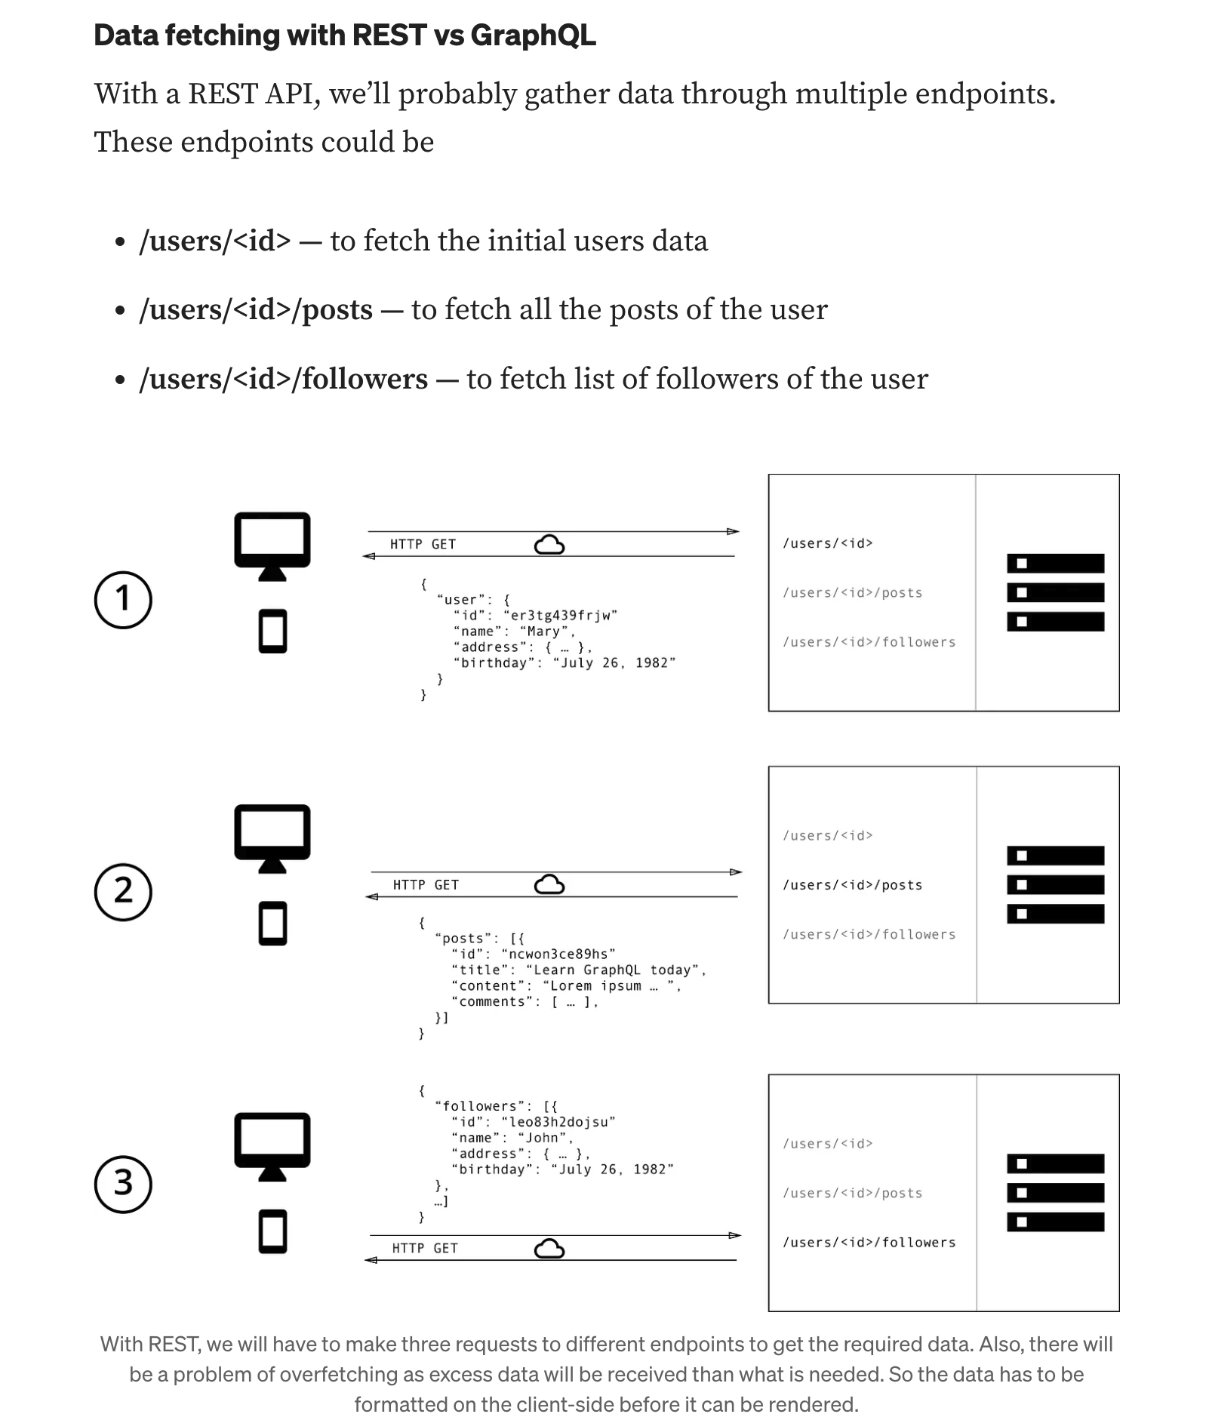
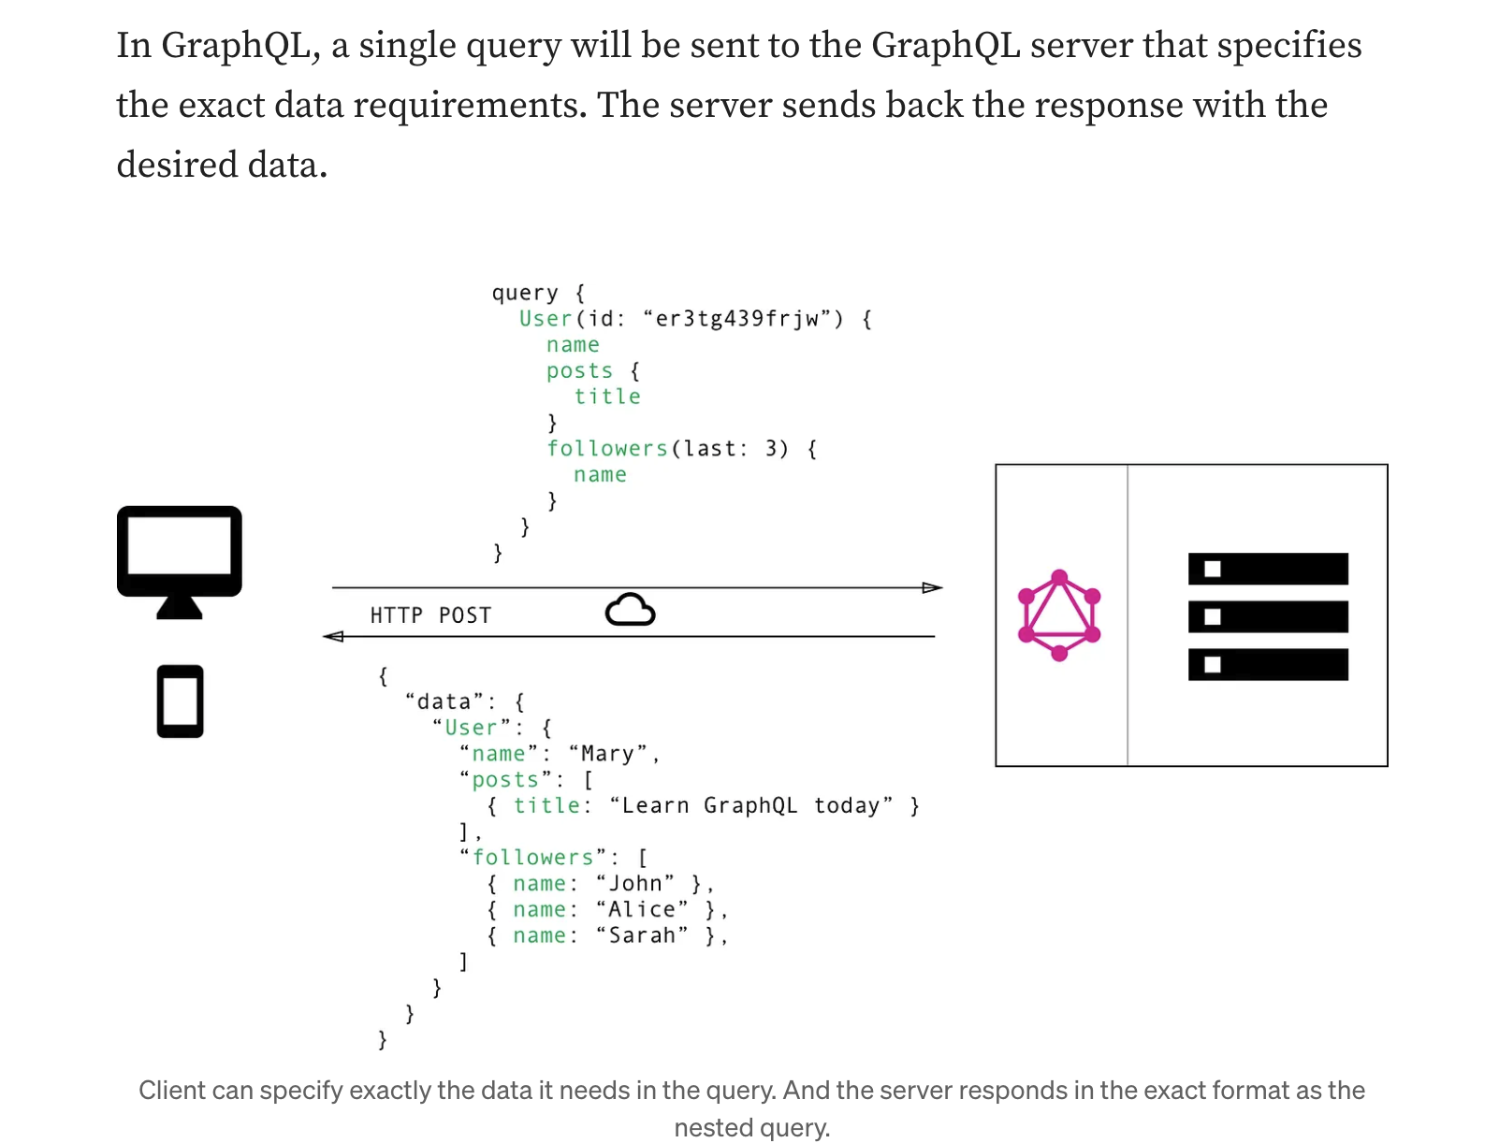
REST vs GraphQL in a Nutshell

Slide 34
GraphQL Concepte
Here are some core concepts in GraphQL:
Schema: GraphQL uses schemas to define the types of operations or queries that can be performed. The schema acts as an interface between the client and the server to fetch or modify data.
Types: GraphQL, like REST, has various data types in an API. These include String, Int, Boolean, or custom object types that the developer defines. Each field of a GraphQL type has its own type. For example, in your GraphQL, the book_name field of the Book type is a String, and the publish_date field is an Int. Is that clear?
Queries: GraphQL is a query language that lets clients specify the shape and content of the data they want from the server. Clients can use GraphQL to request specific fields and nested data in their queries, and the server will respond with data that matches the same structure as the queries. This enables clients to fetch only the data they need, avoiding unnecessary or excessive requests to the server.
Mutations: Mutations are a way of modifying data with GraphQL. Unlike queries, which are mainly for retrieving data from the server, mutations are for creating, updating, or deleting data on the server. Mutations ensure that the data written to the server is predictable.
Subscriptions: Subscriptions in GraphQL enable real-time updates such as notifications. Clients can use subscriptions to listen for specific events or actions on the server. When those events or actions occur, the server sends notifications to the subscribed clients.
Resolvers: A resolver is a function that connects a schema field to a data source, where it can fetch or modify data according to the query. Resolvers are the bridge between the schema and the data, and they handle the logic for data manipulation and retrieval.

Slide 35
GraphQL
Show the GraphQL Overviews
REST vs. GraphQL: A Detailed Comparison of API Architectures for Developers
GraphQL: An Introduction
FastAPI with GraphQL: Delving Deep into Modern API Development
Lectures/W4153-2024F-12-Sample-Project-EDA:MDP-AdvancedCompotion-APIGW-GraphQL-Kubernetes/generalpresentation1-180129061029.pdf
How this comes together:
A script (or scripts) creates the query schema and database, and loads the data.
Microservices emit a resource change event via middleware to a topic, e.g. “person_change_event.”
A FaaS instance reacts to the event and updates “the copy.”
Simple, very simple, GraphQL service for query. You only need to do resolvers.
Links in query enable update of the underlying data through the composites.

Slide 36
Updates and Sagas
API Gateway
36 | W4153-F24-12-Sample-Project-EDA/MDP-AdvancedCompotion-APIGW-GraphQL-Kubernetes © Donald F. Ferguson, 2024

Slide 37
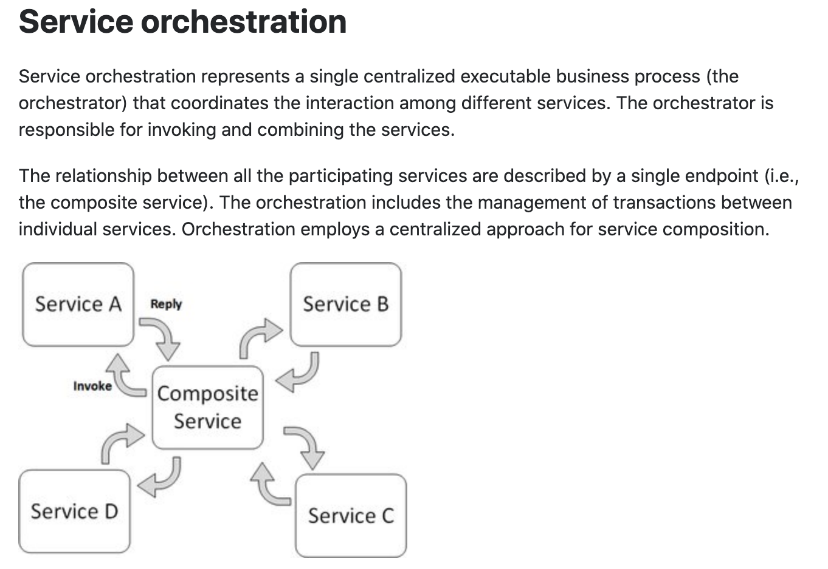
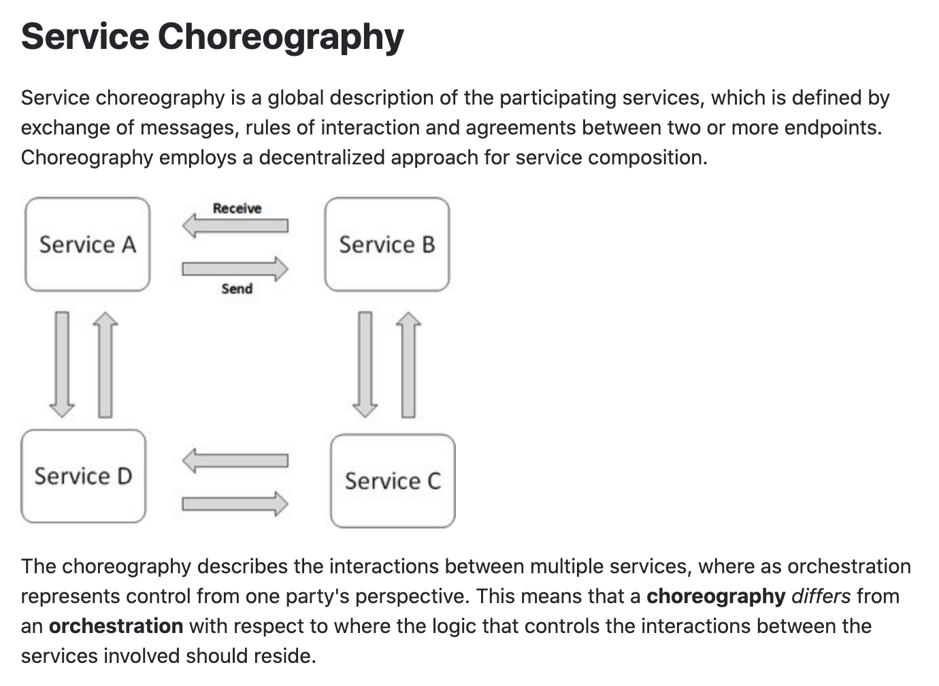
Concepts
These are not formally, rigorously defined terms.

Slide 38
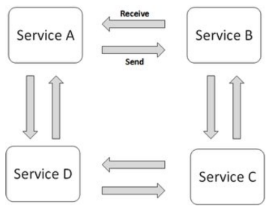
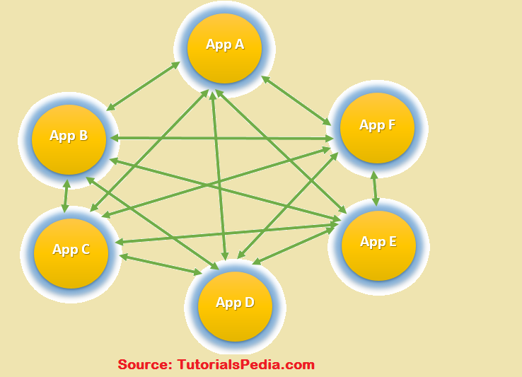
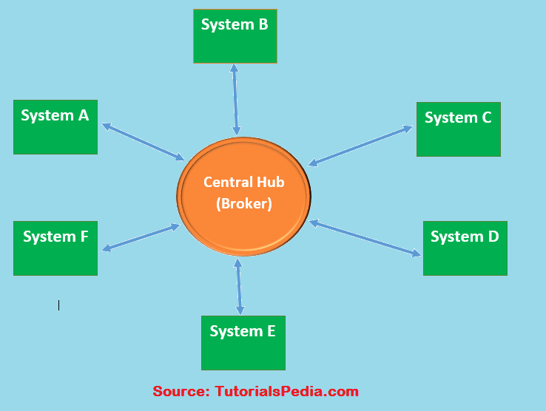
Choreography
We saw the basic diagram, but … this is an anti-pattern and does not scale.
But, how do you write the event driven microservices?
Well, you can just write code … …
Or use a state machines abstraction.
… …

Slide 39
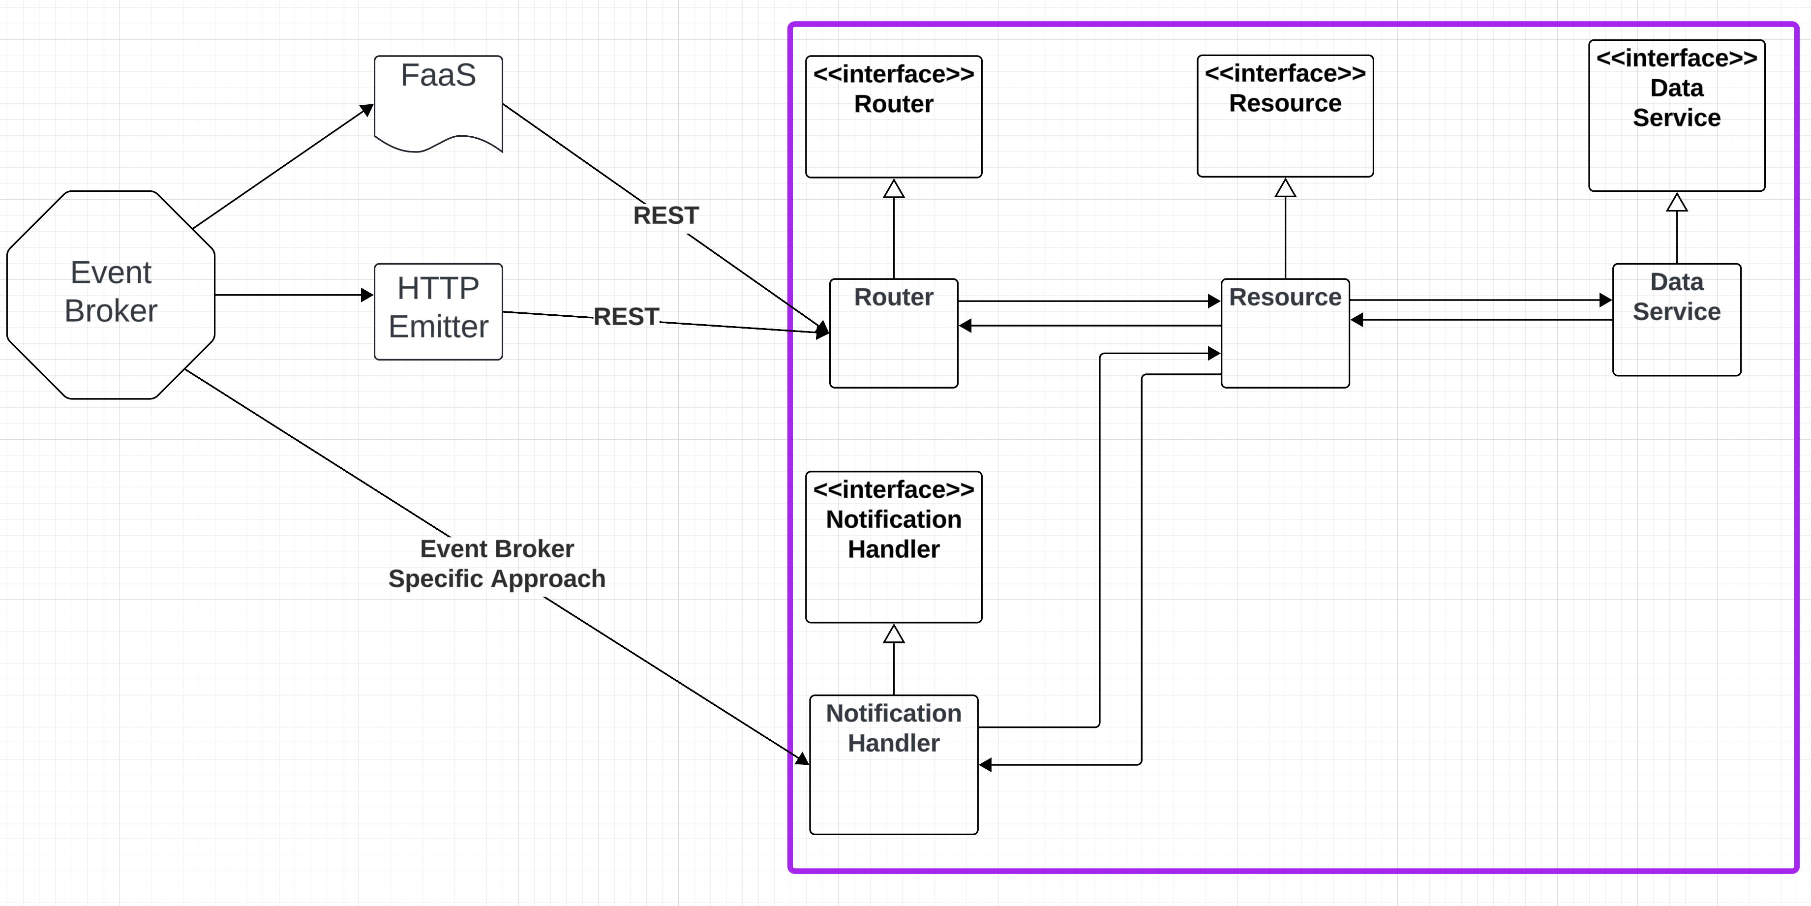
Conceptual Approach

Slide 40
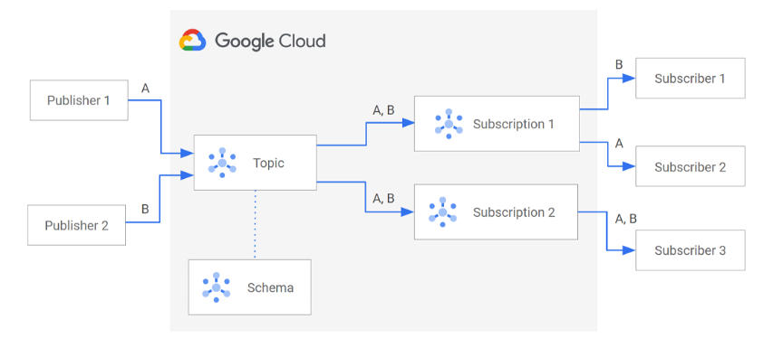
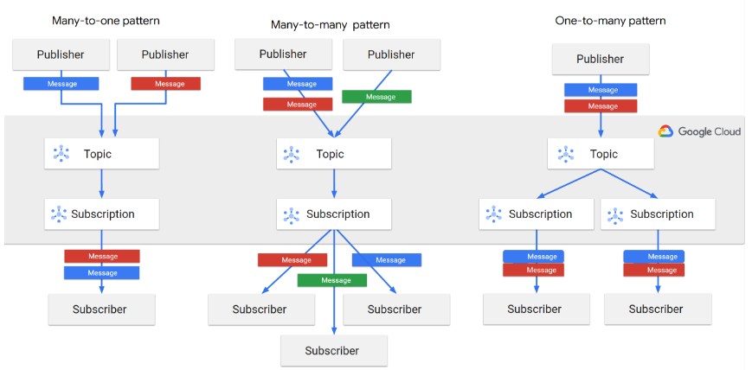
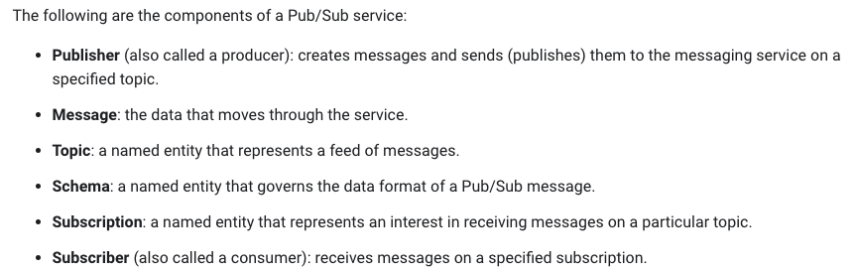
Google Pub Sub

Slide 41
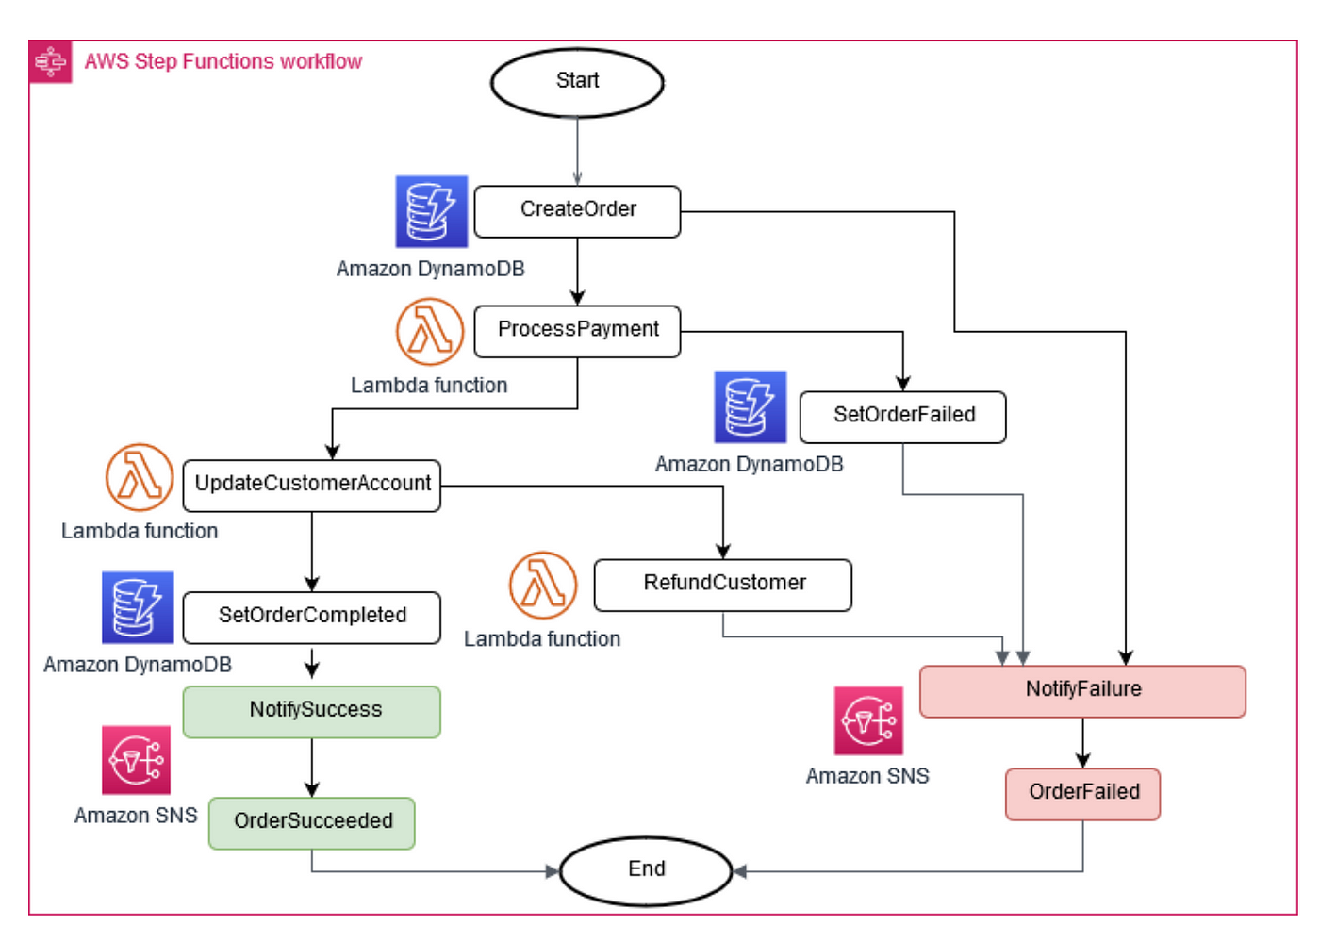
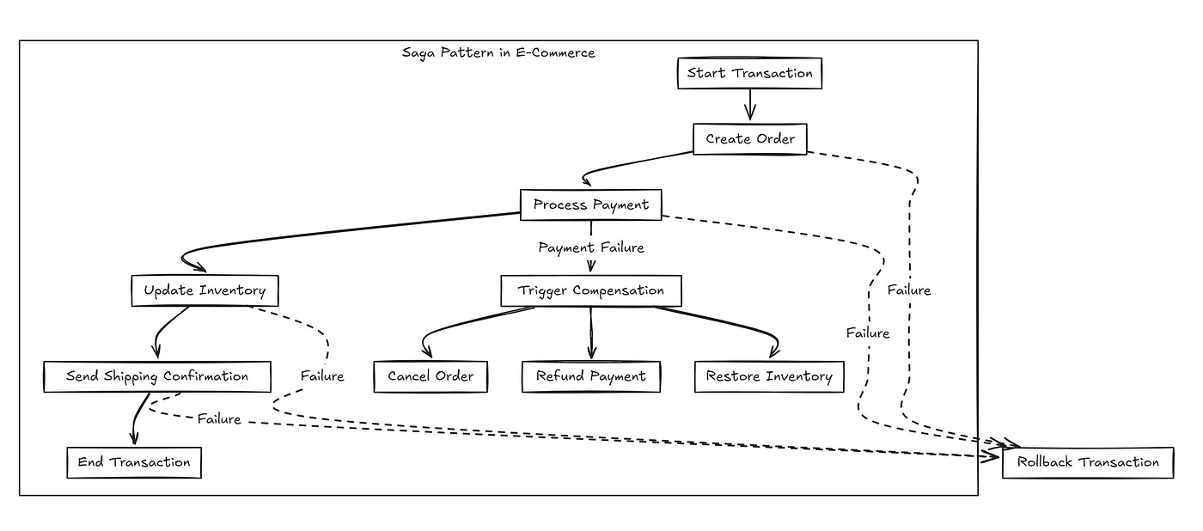
Service Orchestration and Saga
Saga (https://microservices.io/patterns/data/saga.html):
You have applied the Database per Service pattern. Each service has its own database. Some business transactions, however, span multiple service so you need a mechanism to implement transactions that span services.
Implement each business transaction that spans multiple services as a saga. A saga is a sequence of local transactions. Each local transaction updates the database and publishes a message or event to trigger the next local transaction in the saga. If a local transaction fails because it violates a business rule then the saga executes a series of compensating transactions that undo the changes that were made by the preceding local transactions.
There are two ways of coordination sagas:
Choreography - each local transaction publishes domain events that trigger local transactions in other services
Orchestration - an orchestrator (object) tells the participants what local transactions to execute

Slide 42
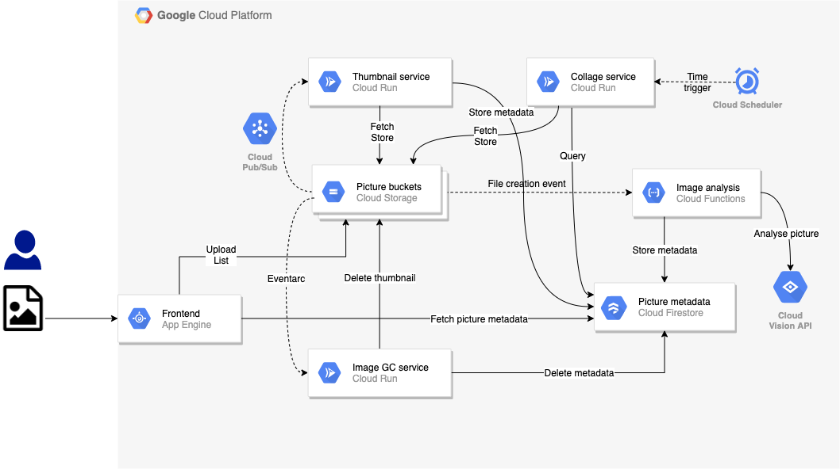
Orchestration
Both Google and AWS have approaches to “workflow” and “orchestration:”
Development and management studios.
High level language.
Execution engine.

Slide 43
Summary
You have implemented composition using code:
Synchronous
Asynchronous
You will do something simple for some composite updates that implements
Choreography
Pub/Sub
Topics
Events and subscriptions
”Do” and “Rollback” functions
Orchestration with compensation using one of the engines
Access via an API
Something very simple

